Slide 1

Team 5 Service Plan
Brian Loughran, Tyler Roth, Mikaila Skaroff

Slide 2

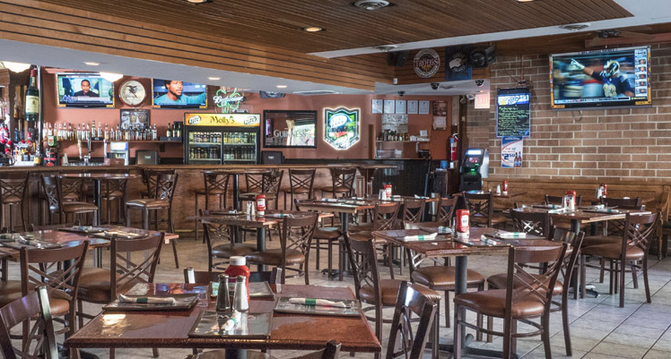

Company Description
Local Southside Eatery and Bar
Located on 4th and New Street in Bethlehem
Description:
Fairly priced
Casual
Comfortable

Slide 3
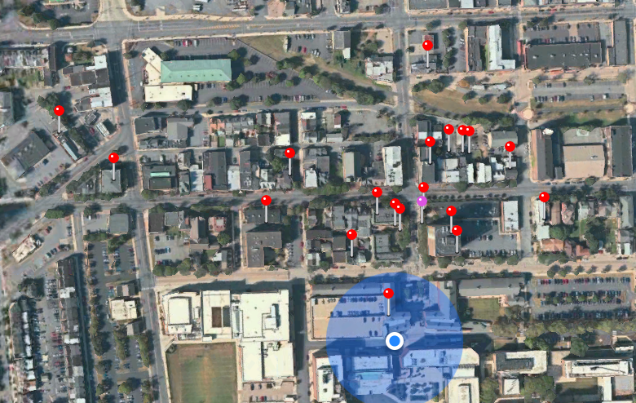
Service Industry and Competitors
Restaurant and Bar Industry
Competitors: Other Southside Bethlehem Restaurants and Bars
Southside Bethlehem - Eateries and Pubs
Molly’s
Sals/La Lupita
Sotto’s/Broadway

Slide 4
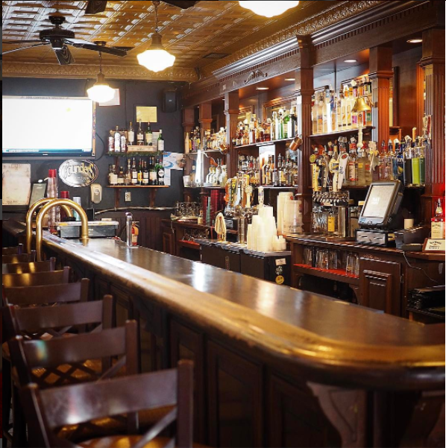
Service Processes
Services Directed at Customers in Person
Delivery both tangible and intangible goods
Food/Drink
Experience
Sequence of Events - an example
Role of Information
Website, social media, word of mouth

Slide 5
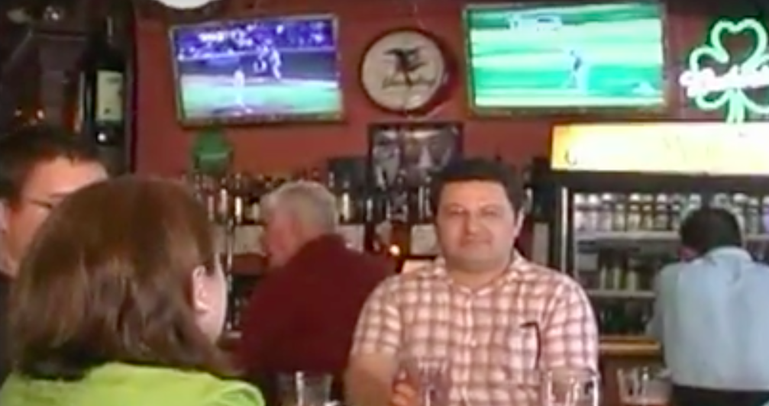
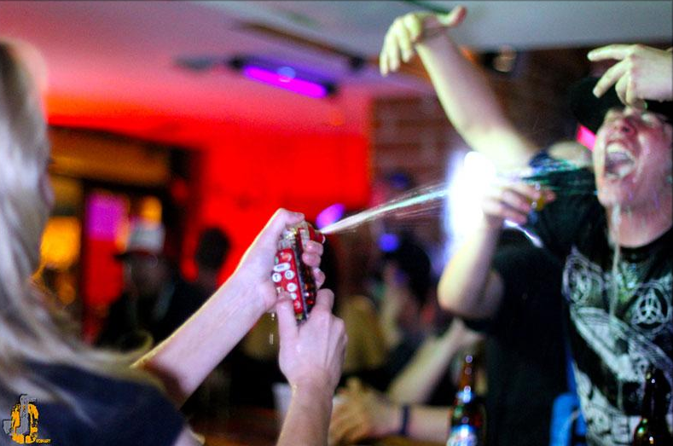
Our Customers
High contact personnel and facilities
Also low contact personnel
Key characteristics of market segment?
Customer relationships worth preserving?
Dining and events - expectation and customer value

Slide 6
Core and Supplementary Elements

Slide 7
Prices

Slide 8
Communication

Slide 9
Service Delivery Options

Slide 10
Productivity vs. Quality

Slide 11
Demand vs. Productive Capacity

Slide 12
Roles for People and Technology

Slide 13
Service Leadership

Slide 14
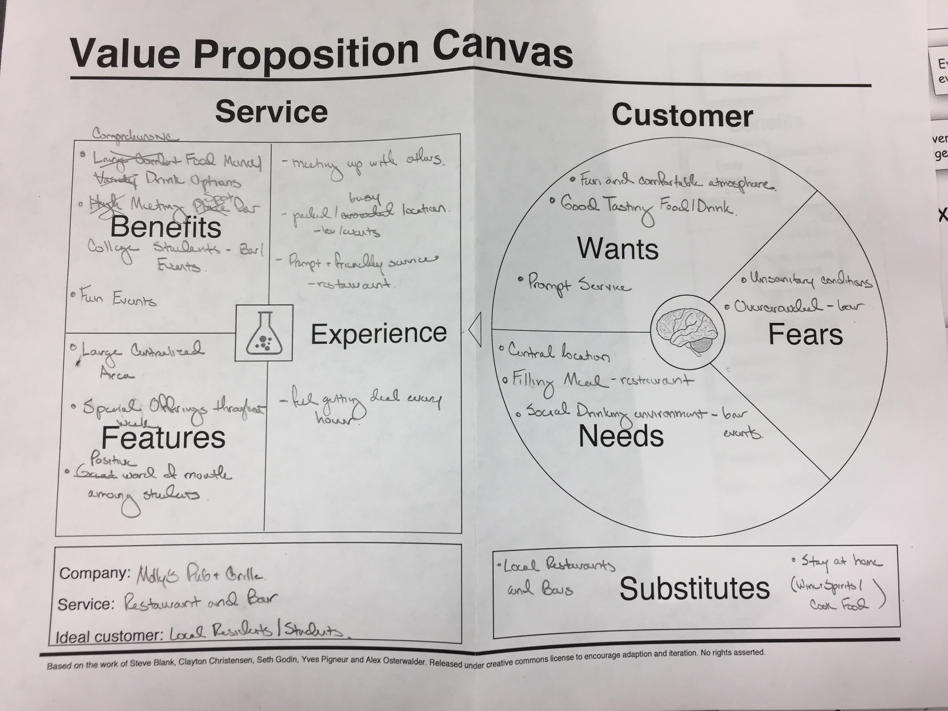
Value Proposition Canvas

Slide 15
Service Blueprint

Slide 16
Proposed Redesign

